Slide 1
Using Lock5 Statistics: Unlocking the Power of Data
Afternoon Session
Patti Frazer Lock
University of Kentucky
June 2015

Slide 2
Instructor Resources
PowerPoint slides for every section
Clicker questions for every section
Notes and suggestions for every section
Instructor video for every section
Class worksheet(s) for every section
Class activity for every section
Videos for every example and every learning goal
WileyPLUS (with most content designed by us)
Software manuals for R, Minitab, Fathom, Excel, SAS, SPSS, TI calculators
Datasets ready to import in all these formats
Test bank

Slide 3
In addition to the Manual for R that is written specifically to accompany the text:
Free access to Lock5withR, available at:
https://github.com/rpruim/Lock5withR
(Code to run every example in the text, in addition to lots of other great things.)
If interested: weekly labs in R written for use with the text.

Slide 4
Table of Contents
Chapter 1: Collecting Data
Chapter 2: Describing Data
Chapter 3: Confidence Intervals
Chapter 4: Hypothesis Tests
Chapter 5: Normal Distribution
Chapter 6: Short-Cut Formulas

Slide 5
Chapter 1: Collecting Data
Why is this first?
Comes first in actual analysis
More interesting than histograms and mean/median!
Data!
Categorical vs Quantitative Variables
Concept of a dataset with cases as rows and variables as columns
Data Collection
“Random” in random sampling does not mean haphazard!
And you can NOT do random!
Randomized experiment necessary to make conclusions about causality
ALWAYS think about how the data were collected before making conclusions

Slide 6
Context
Ann Landers column asked readers
“If you had it to do over again, would you have children?
70% said “no” and 30% said “yes”
Newsday then conducted a random sample of all US adults:
9% said “no” and 91% said “yes”

Slide 7
Chapter 1: Collecting Data
Focus is not on memorizing methods, but on thinking critically about how data are collected
Should be fun and interesting!
(See Instructor Resources)
Relatively hard to assess
Can give only minimal coverage to some of the details if desired

Slide 8
Chapter 2: Describing Data
Pretty straightforward
Outline:
Single variables
Categorical
Quantitative
Relationships between variables
Two categorical
One categorical and one quantitative
Two quantitative
Discuss relevant graphs and summary statistics in each case

Slide 9
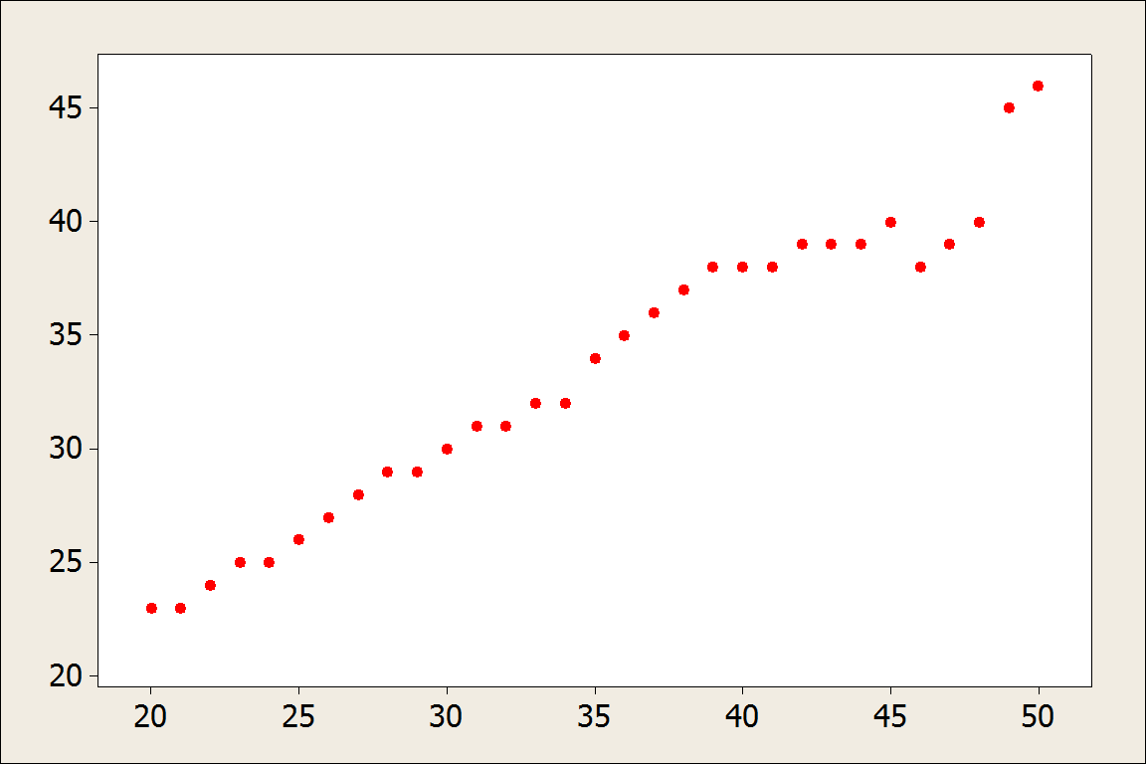
OKCupid: What age do users find most attractive?
X-axis: age of OK Cupid heterosexual females
Y-axis: average age of males they rated most attractive

Slide 10
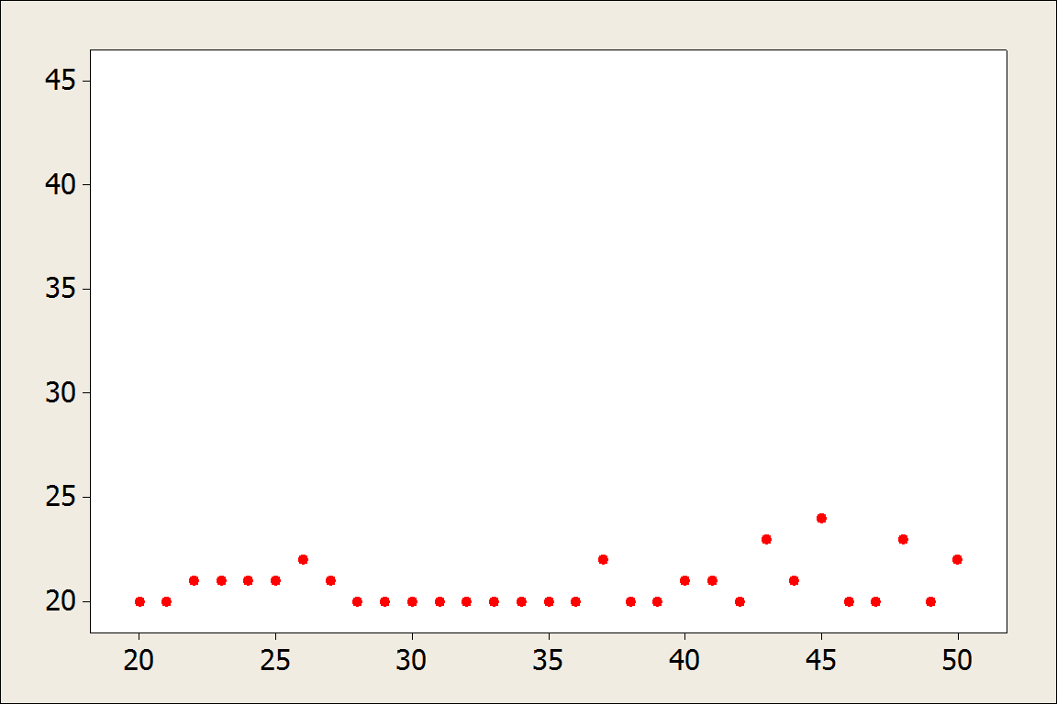
OKCupid: What age do users find most attractive?
X-axis: age of OK Cupid heterosexual males
Y-axis: average age of females they rated most attractive

Slide 11
Chapter 2: Describing Data
All graphs and most statistics found using technology
Use interesting datasets!
Reinforce ideas from Chapter 1
Possibly introduce StatKey or other relevant software at this point
www.lock5stat.com/statkey

Slide 12
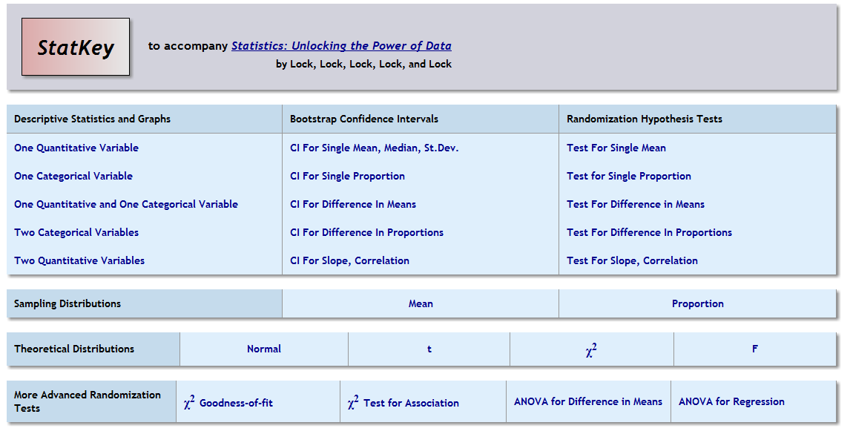
StatKey
www.lock5stat.com/statkey

Slide 13
Unit A Essential Synthesis
One day
Flipped classroom
Integrate ideas from Chapters 1 and 2

Slide 14
Chapter 3: Confidence Intervals
Sampling variability/Sampling distributions
Concepts of “margin of error” and “standard error”
Concept of a confidence interval or interval estimate
StatKey might be helpful

Slide 15
StatKey
www.lock5stat.com/statkey

Slide 16
Chapter 3: Confidence Intervals
Sampling Distribution:
Have access to entire population
Take many samples of the same size and record some statistic
Not feasible in practice!
Bootstrap Distribution
Only have one sample
Take many samples of the same size (with replacement) from that one sample and record some statistic
Feasible!! And gives same approximate shape and standard error!!

Slide 17
Chapter 3: Confidence Intervals
Using Bootstrap Distributions to reinforce the ideas of:
Sampling variability/Sampling distributions
Margin of error
Standard error
Interval estimate that is likely to contain the true value of the parameter
The fact that the sample must be representative of the population!

Slide 18
Chapter 3: Confidence Intervals
Using Bootstrap Distributions to construct confidence intervals:
Using: Statistic ± 2· SE
(helps get them used to the formulas that will come later)
Using middle 95%
(helps them understand confidence level)

Slide 19
StatKey
www.lock5stat.com/statkey

Slide 20
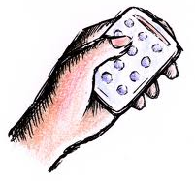
A 98% confidence interval for mean pulse rate is 65 to 71. The interpretation “I am 98% sure that all students will have pulse rates between 65 and 71” is
Correct
Incorrect
A confidence interval gives us information about a population parameter (the mean), not individual students.

Slide 21
A 98% confidence interval for mean pulse rate is 65 to 71. The interpretation “I am 98% sure that the mean pulse rate for this sample of students will fall between 65 and 71” is
Correct
Incorrect
A confidence interval gives us information about a population parameter (the mean of all students), not the mean of the sample.

Slide 22
A 98% confidence interval for mean pulse rate is 65 to 71. The interpretation “I am 98% sure that the mean pulse rate for the population of all students will fall between 65 and 71” is
Correct
Incorrect

Slide 23
A 98% confidence interval for mean pulse rate is 65 to 71. The interpretation “98% of the pulse rates for students at this college will fall between 65 and 71” is
Correct
Incorrect
A confidence interval gives us information about a population parameter (the mean for all students), not individual students.

Slide 24
Chapter 3: Confidence Intervals
At the end of this chapter, students should be able to understand and interpret confidence intervals (for a variety of different parameters)
(And be able to construct them using the bootstrap method) (which is the same method for all parameters)

Slide 25
Chapter 4: Hypothesis Tests
Starts with stating null and alternative hypotheses
For mean
For proportion
For difference in means
For difference in proportions
(For correlation)
Understanding the idea behind a hypothesis test
Using sample data to generalize a conclusion to a population
Stick with the null unless evidence is strong for the alternative

Slide 26
Introducing Hypothesis Tests
Section 4.1

Slide 27
Hypotheses
Take a minute to write down the hypotheses for each of the following situations:
Does the proportion of people who support gun control differ between males and females?
Is the average hours of sleep per night for college students less than 7?
H₀: p_{f} = p_{m}
H_{a}: p_{f} ≠ p_{m}
p_{f}: proportion of females who support gun control
p_{m}: proportion of males who support gun control
H₀: μ =7
H_{a}: μ < 7
μ: average hours of sleep per night for college students

Slide 28
Chapter 4: Hypothesis Tests
Key Idea: A p-value measures strength of evidence against the null hypothesis and in support of the alternative hypothesis
Smaller p-values mean stronger evidence for the alternative hypothesis!!
Be able to state the generic conclusion (Reject or do not reject the null hypothesis) and be able to state the conclusion in context
Can minimize many details

Slide 29
StatKey
www.lock5stat.com/statkey

Slide 30
Chapter 4: Hypothesis Tests
At the end of this chapter, students should be able to state hypotheses, interpret a p-value, give conclusion in context (for a variety of different parameters)
(And be able to find a p-value using the randomization method)

Slide 31
By this point in the course, students have all the key ideas of inference!!!!
Take your time through Chapters 3 and 4
You can make up the time later – Chapters 5 and 6 go quickly!

Slide 32
Unit B Essential Synthesis
One day
Flipped classroom
Integrate ideas from Chapters 1 through 4

Slide 33
Chapter 5: Normal Distribution
Finding probabilities and cutoff values on a normal distribution
Using a distribution for confidence intervals:
And hypothesis tests:
$$Sample Statistic±z^{∗}∙SE$$
$$t.s.=\frac{Sample Statistic −Null Parameter}{SE}$$

Slide 34
StatKey
www.lock5stat.com/statkey

Slide 35
Chapter 6: Short-cut Formulas
Proportions or means first?
One sample or two first?
Confidence intervals or hypothesis tests first?

Slide 36
Chapter 6: Short-cut Formulas
Short sections can be covered in any order you want!!
Proportions or means first
One sample or two first
Confidence intervals or hypothesis tests first
Can be covered quickly! Mostly just lots of new SE formulas! Do more than one section a day!!!

Slide 37
Chapter 6: Short-cut Formulas
6.1: Distribution for Proportion
6.2: CI for Proportion
6.3: HT for Proportion
6.4: Distribution for Mean
6.5: CI for Mean
6.6: HT for Mean
6.7: Distribution for Difference in Proportions
6.8: CI for Difference in Proportions
6.9: HT for Difference in Proportions
6.10: Distribution for Difference in Means
6.11: CI for Difference in Means
6.12: HT for Difference in Means
6.13: Inference for Paired Difference in Means

Slide 38
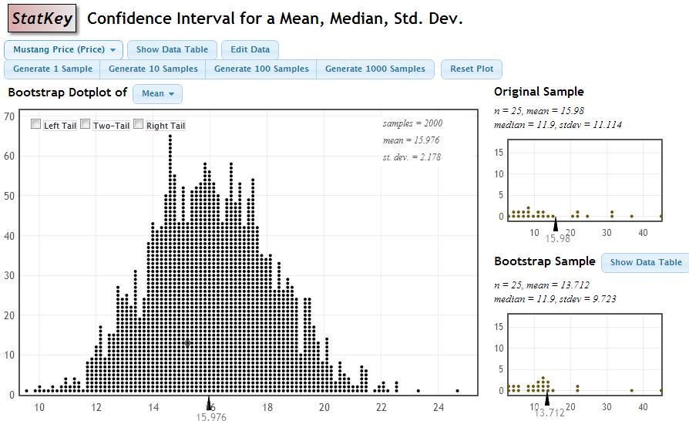
StatKey
Sample stats
$$SE=\frac{s}{\sqrt{n}}=\frac{11.114}{\sqrt{25}}=2.22$$

Slide 39
Additional Topics
Chi-square Tests (Chapter 7)
ANOVA for difference in means (Chapter 8)
Inference for simple regression (Chapter 9) and multiple regression (Chapter 10)
These can be done in any order
(Also, probability – chapter 11 – can be omitted or covered at any point in the course)

Slide 40
StatKey
www.lock5stat.com/statkey

Slide 41
Instructor Resources
PowerPoint slides for every section
Clicker questions for every section
Notes and suggestions for every section
Instructor video for every section
Class worksheet(s) for every section
Class activity for every section
Videos for every example and every learning goal
WileyPLUS (with most content designed by us)
Software manuals for R, Minitab, Fathom, Excel, SAS, SPSS, TI calculators
Datasets ready to import in all these formats
Test bank

Slide 42
Instructor Resources
www.wiley.com

Slide 43
Feel free to contact me or any of the authors at any time if you have any questions or suggestions for improvement. Thanks! lock5stat.com plock@stlawu.edu

