Slide 1
Adapting a Randomization-Based Perspective in Your Introductory Statistics Course
Patti Frazer Lock
Cummings Professor of Mathematics
St. Lawrence University
JSM 2011
Miami Beach, FL

Slide 2
Round 3: Getting Started
“What were your reasons for getting involved with randomization-based techniques?”

Slide 3
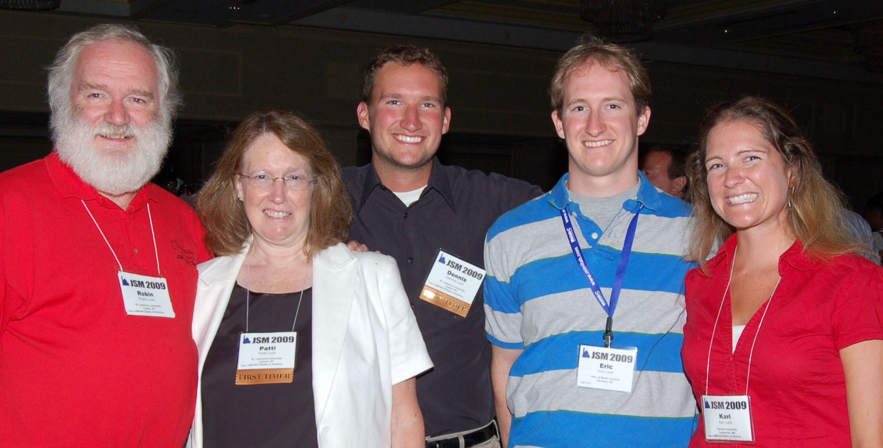
The Lock⁵ Team
Dennis
Iowa State
Kari
Harvard/Duke
Eric
UNC- Chapel Hill
Robin & Patti
St. Lawrence

Slide 4
“What were your reasons for getting involved with randomization-based techniques?”
Part 2…

Slide 5
The underlying concepts behind intervals and tests are hard. Simulation methods can help build intuitive understanding of the key ideas.

Slide 6
“What were your reasons for getting involved with randomization-based techniques?”
Part 3…

Slide 7
It’s the way of the past …
"Actually, the statistician does not carry out this very simple and very tedious process, but his conclusions have no justification beyond the fact that they agree with those which could have been arrived at by this
elementary method."
-- Sir R. A. Fisher, 1936

Slide 8
… and the future.
“... despite broad acceptance and rapid growth in enrollments, the consensus curriculum is still an unwitting prisoner of history. What we teach is largely the technical machinery of numerical approximations based on the normal distribution and its many subsidiary cogs. This machinery was once necessary, because the conceptually simpler alternative based on permutations was computationally beyond our reach. Before computers statisticians had no choice. These days we have no excuse. Randomization-based inference makes a direct connection between data production and the logic of inference that deserves to be at the core of every introductory course.”
-- Professor George Cobb, 2007

Slide 9
In other words, this is not just a way to teach statistics in a more intuitive way….
It is also a way to DO statistics that is likely to become increasingly important.

Slide 10
Status:
Robin taught using these materials last Fall, as a module in an existing course.
Robin and I (at St. Lawrence University) and Kari (at Duke) and other class testers at different institutions will be using these materials exclusively as a complete overhaul of the intro course this Fall.

Slide 11
How did it go last Fall?
Students enjoyed and were engaged with the new approach.
Instructor enjoyed and was engaged with the new approach.
Better understanding of p-value reflecting “if H₀ is true”.
Better interpretations of intervals.

Slide 12
An Actual Assessment
Final exam: Find a 98% confidence interval using a bootstrap distribution for the mean amount of study time during final exams
Results:
26/26 had a correct bootstrap distribution
24/26 had a correct interval
23/26 had a correct interpretation

Slide 13
So far, we’re believers!
(And we’ll know much more by January.)

Slide 14
Thank you for listening.
For more information:
www.lock5stat.com

